Slide 1
MedAssist AI 🏥AI-Powered Healthcare Assistance Platform
Disease Prediction and Risk Assessment — review for academic mentor
Milestone 2 Disease Prediction and Risk Assessment
Karumanchi Hemanth
8/13/2026

Slide 2
Milestone 2 Deliverables
MILESTONE 1
Foundation ↓ 👤 Patient Management ↓ 🩺 Health Data Collection ↓ 🤖 AI Prediction Foundation ↓ 👨‍⚕️ Caretaker Management ↓ MILESTONE 2 AI + Integration + Advanced Features
01 — AI Model Development Disease classification with full ML pipeline
02 — Patient Dashboard Symptom input, prediction & recommendations.
03 — Caretaker Dashboard Assigned patient monitoring & role-based access.
04 — System Integration React → FastAPI → PostgreSQL end-to-end
Python • Scikit-learn • FastAPI • PostgreSQL • React

Slide 3
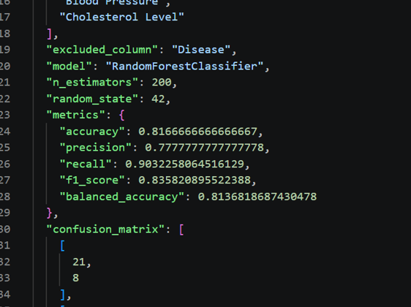
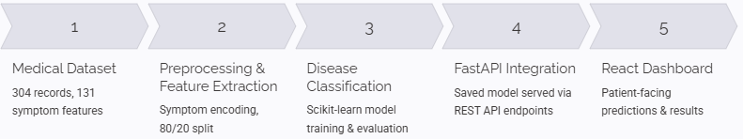
AI Model Development
TRAINING – DATASET - EVALUATION
304 Unique Records
Total labeled medical records in the training dataset
41
Disease Classes
Distinct conditions the model is trained to classify
131
Disease Classes
Symptom Features
Binary symptom input features per patient
ML Workflow Pipeline

Slide 4
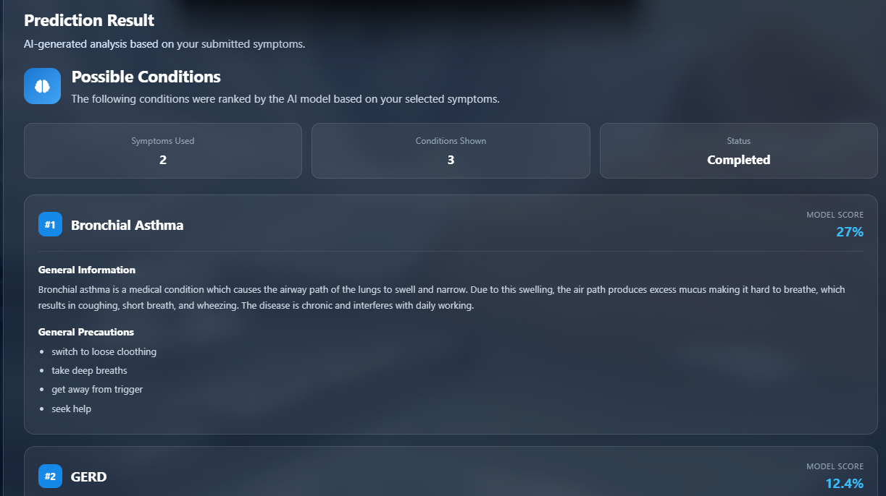
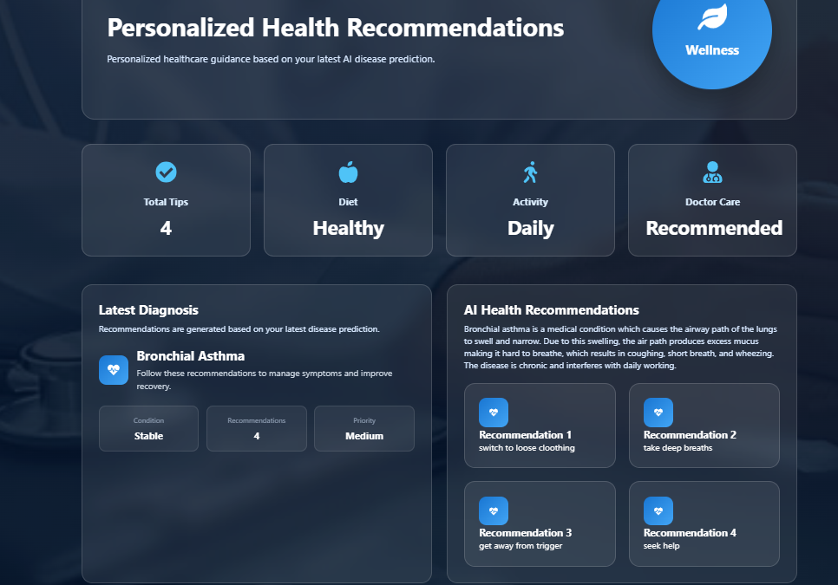
Patient Dashboard
AI-Powered Patient Health Assistance
Patient Profile
Account setup and personal health information
Add Symptoms
Input, save, update, or delete symptom entries
Disease Prediction
AI ranks possible conditions with probability scores
Medical History
Longitudinal record of symptoms, predictions, and assessments
Recommendations
Disease-specific precautions from recommendation dataset
Risk Assessment
Health-risk indicator evaluation and results
Patient Workflow

Slide 5
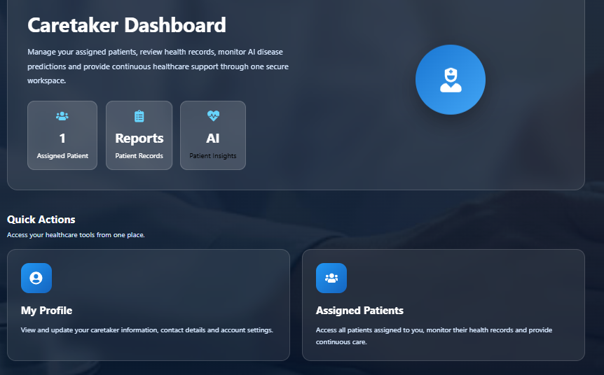
Caretaker Dashboard
Assigned Patients Monitoring & Role-Based Access
Caretaker Login
Authenticated access via role-based credentials
Assigned Patients
List of patients assigned to the caretaker
Select Patient
Navigate to individual patient record
View Patient Details
Profile, contact information, and health information
Review Health Information
Symptoms, predictions, risk assessments, and reports
Monitor Patient History
Longitudinal health records and medical report access
Caretaker Workflow

Slide 6
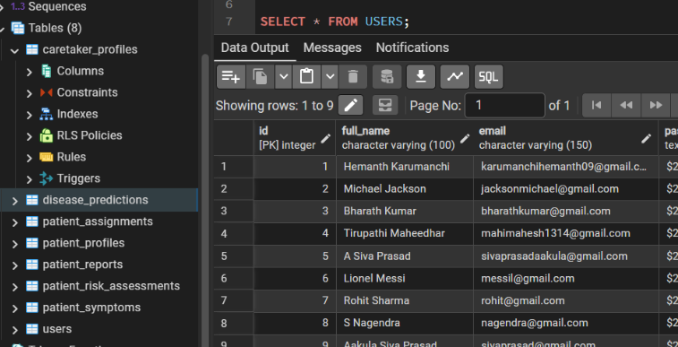
Database & System Integration
Data Storage – PostgreSQL Shema
User & Access Data
Users and authentication credentials
Patient profiles
Caretaker profiles
Patient–caretaker assignment records
Health Data
Symptoms and severity scores
Disease prediction results
Risk assessment outputs
Medical history records
Report Data
Medical report metadata
File information and storage references
Patient ownership and access linkage

Slide 7
